Slide 1

BY: V2S (SASTRA)

Slide 2
PROBLEM OVERVIEW
78%
65M
0
of Indian college students & first- time earners have zero financial training.
first time earners- interns, gig workers, fresh graduates- lack of personal financial advisors.
exisitng tools reason about India- specific expenses like EMI’s, UPI spends and family remittances.

Slide 3




CORE CHALLENGE
build a website were users can enter monthy income and spending. An LLM analyses pattern and flags unhealthy habits, along with conversational follow up (intiated by users) if needed.
Conversational AI coach
Spending analysis
LLM powered Q and A with persistent session context with multilingual interface.
8+ categories and pattern detection and risk flagging
Savings Roadmap
Report Card
Goal-based saving plan
Health Score with grade A-F

Slide 4
ENHANCED FEATURES
01
Spending personality quiz
02
Goal-Based Tracker
Spender, Saver or impulsive buyer- customizes coaching tone
Sets a goal and gets a visual of week-by-week progress.
03
Bad habit interventions
04
Multilingual support
Detects repeated patterns across sessions & sends push notifcations.
LLM responses in English+ Hindi+ one regional language
05
Monthly Report card
Auto-generated visual report with health score, grade and top 3 improvements

Slide 5
IMPACT
Gives India’s 65 million first-time earners a personalized financial advisor- a service currently only affordable by the wealthy.
Reducing debt traps that derial young earners within the first two of their income
65 M
First-time earners impacted

Slide 6
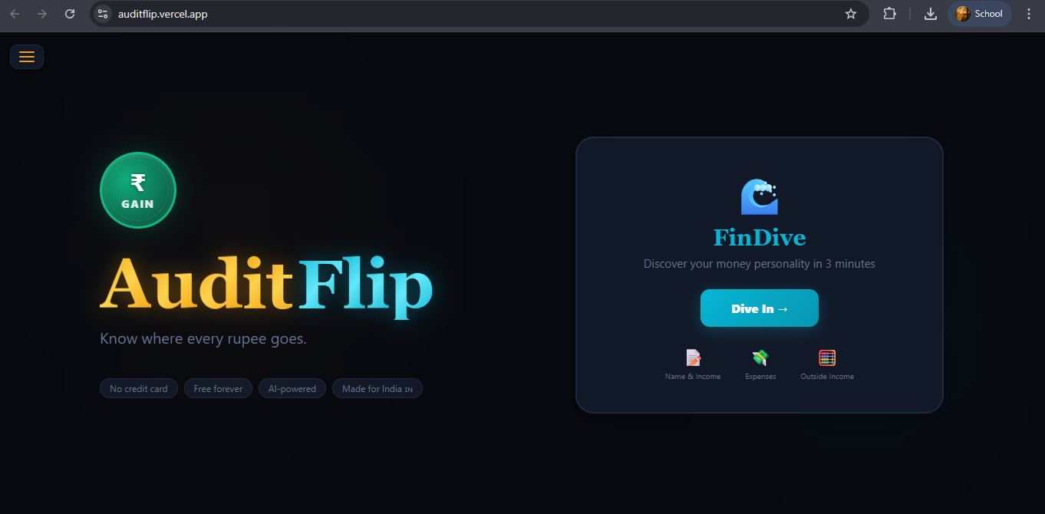
Click on this to get started

Slide 7
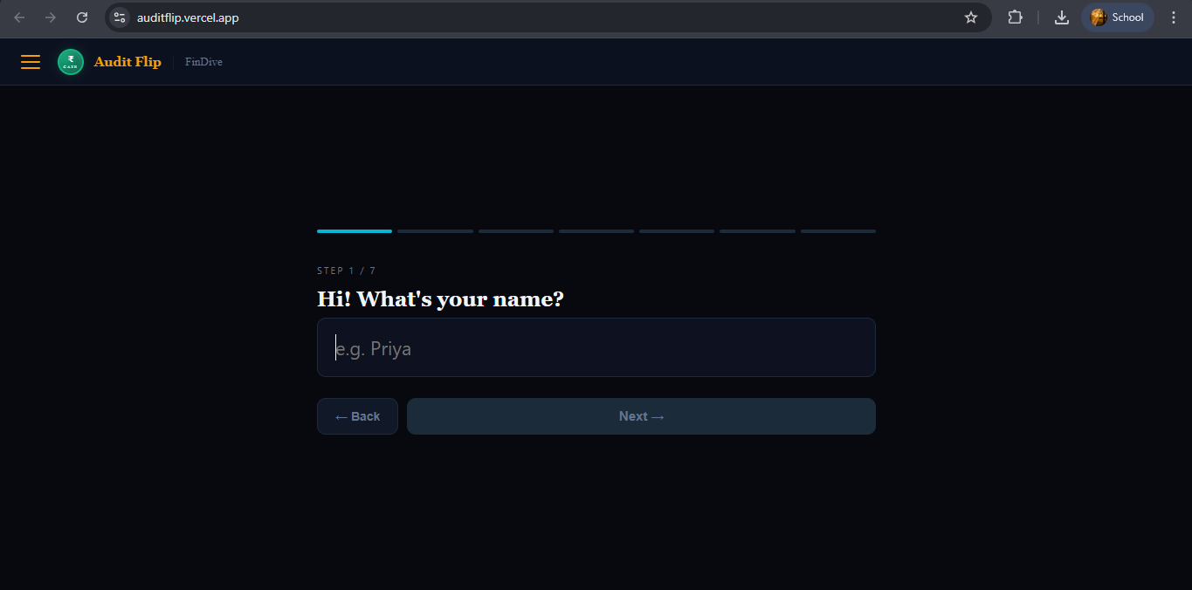
Enter your name

Slide 8
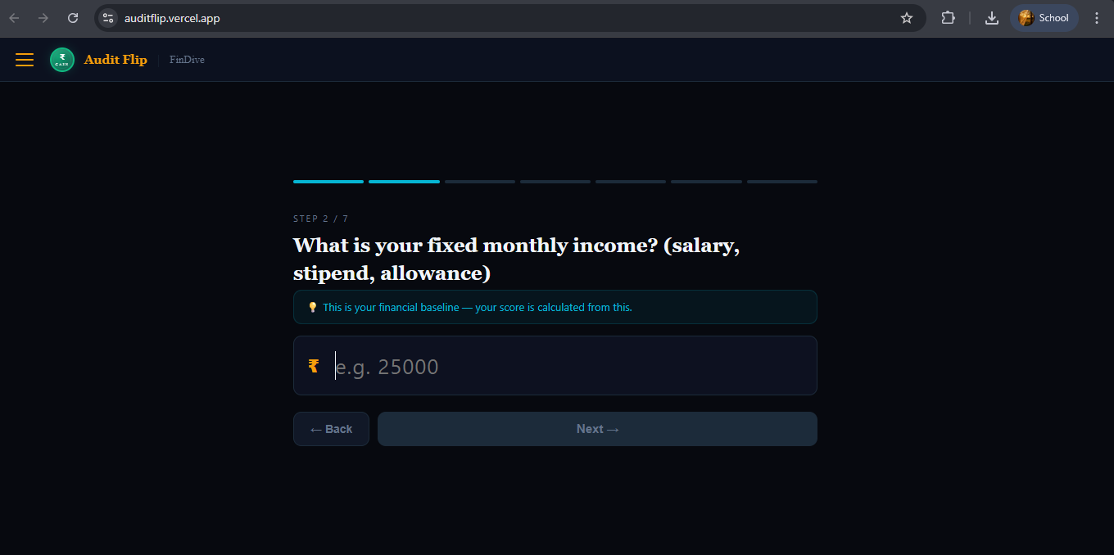
Enter your Take-home pay

Slide 9
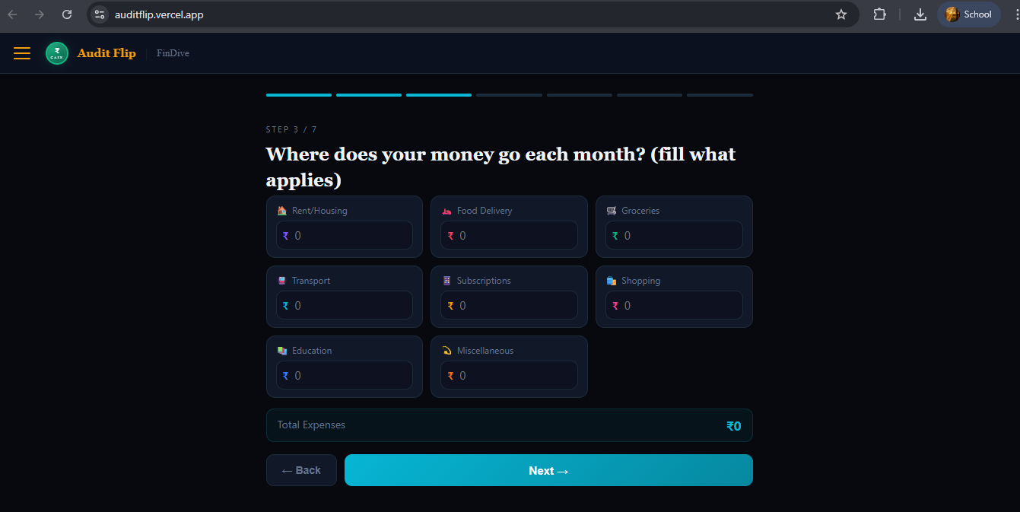
Enter amounts to applicable category
Automatic expense calculation

Slide 10
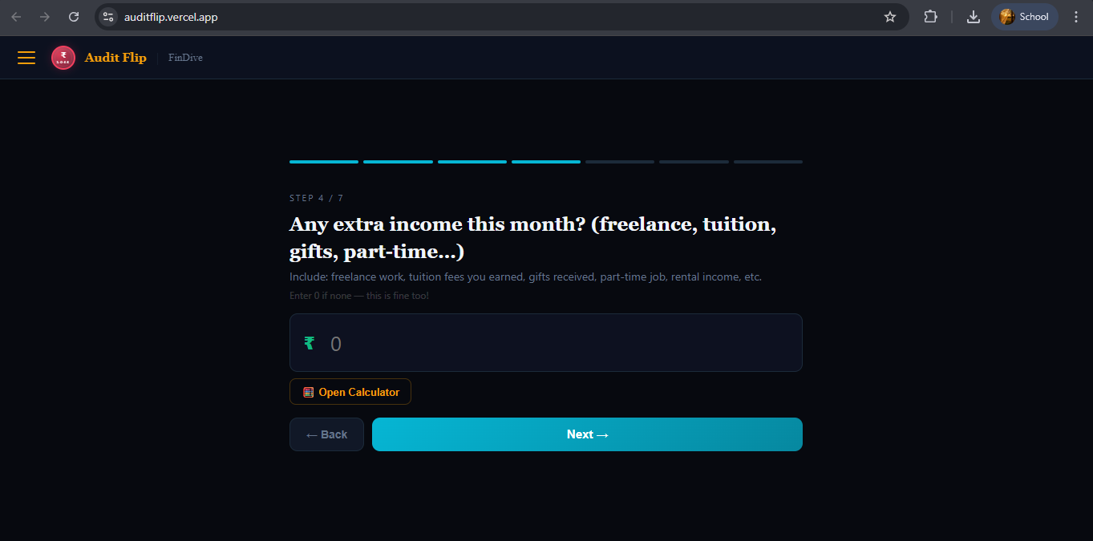
Add any excess income
Use calculator to do basic operations

Slide 11
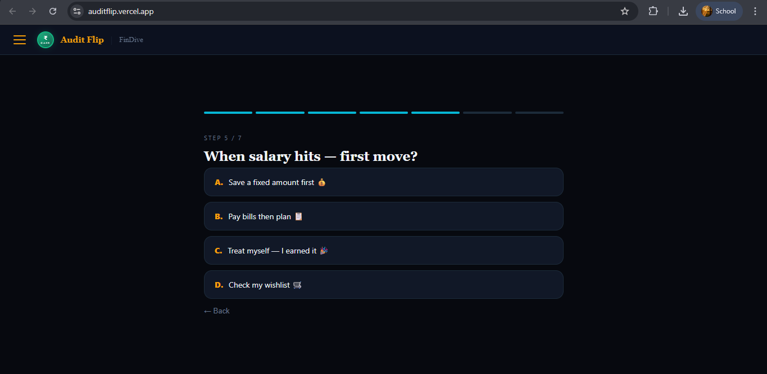
Choose appropriate option

Slide 12
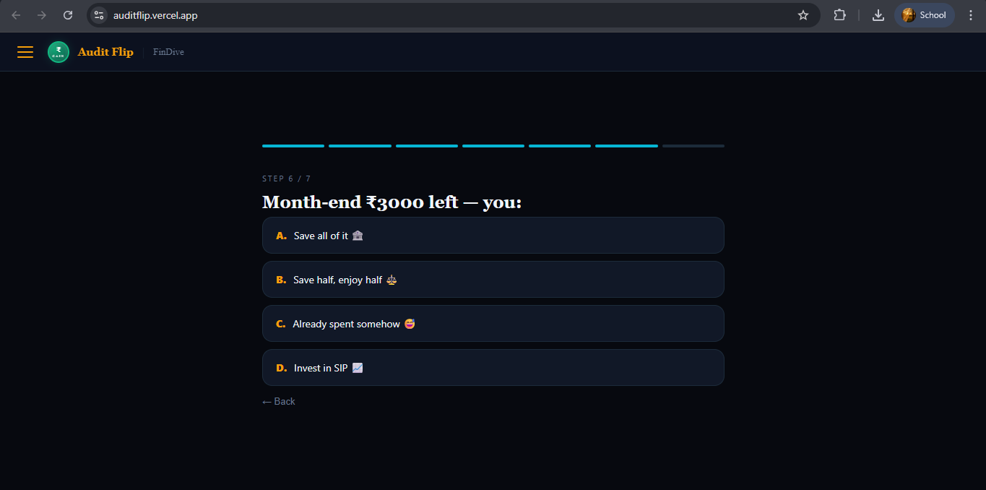

Slide 13
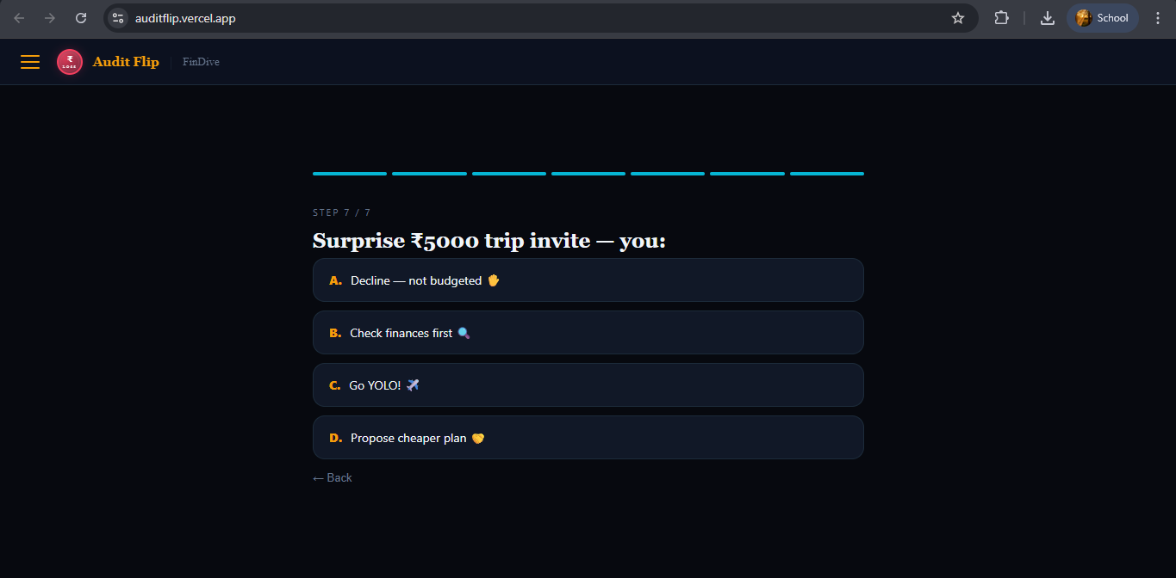

Slide 14
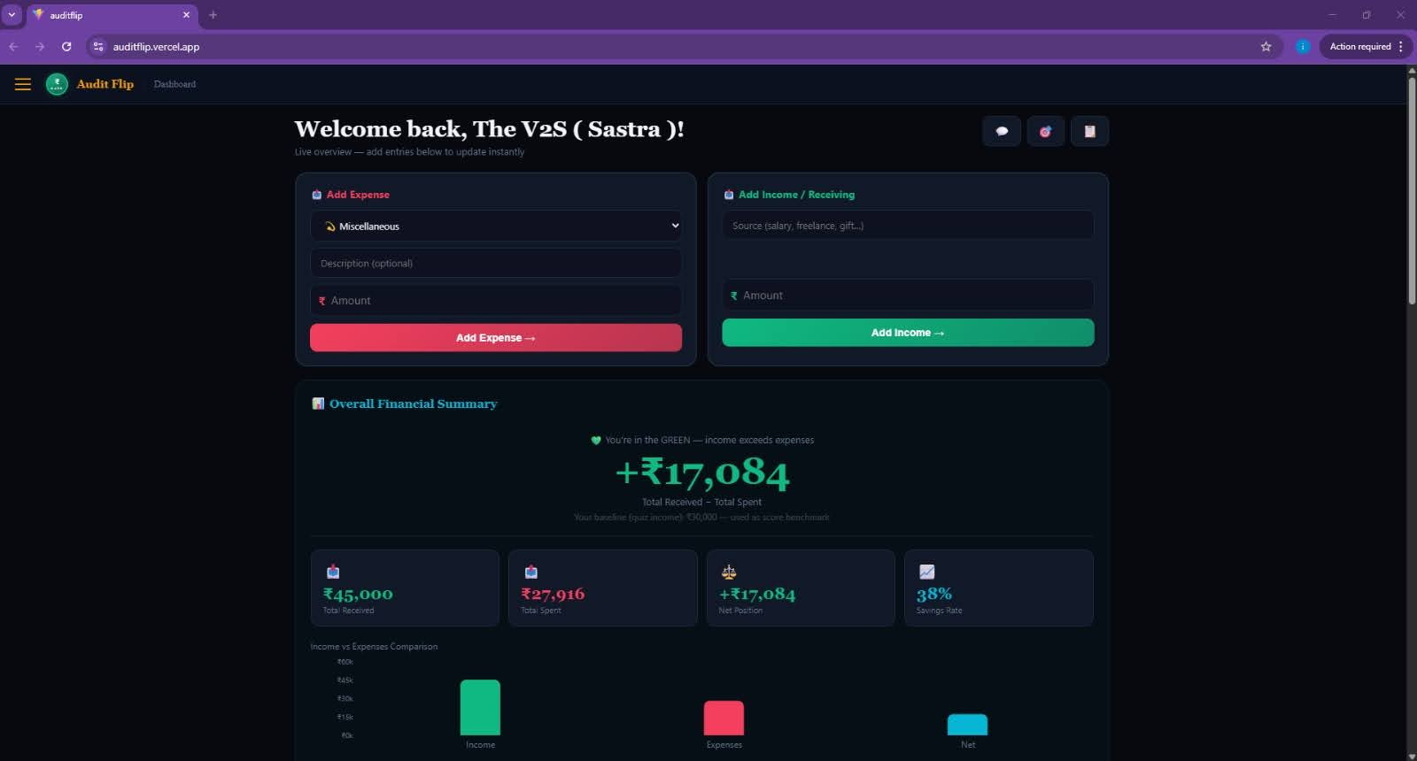
The dashboard opens

Slide 15
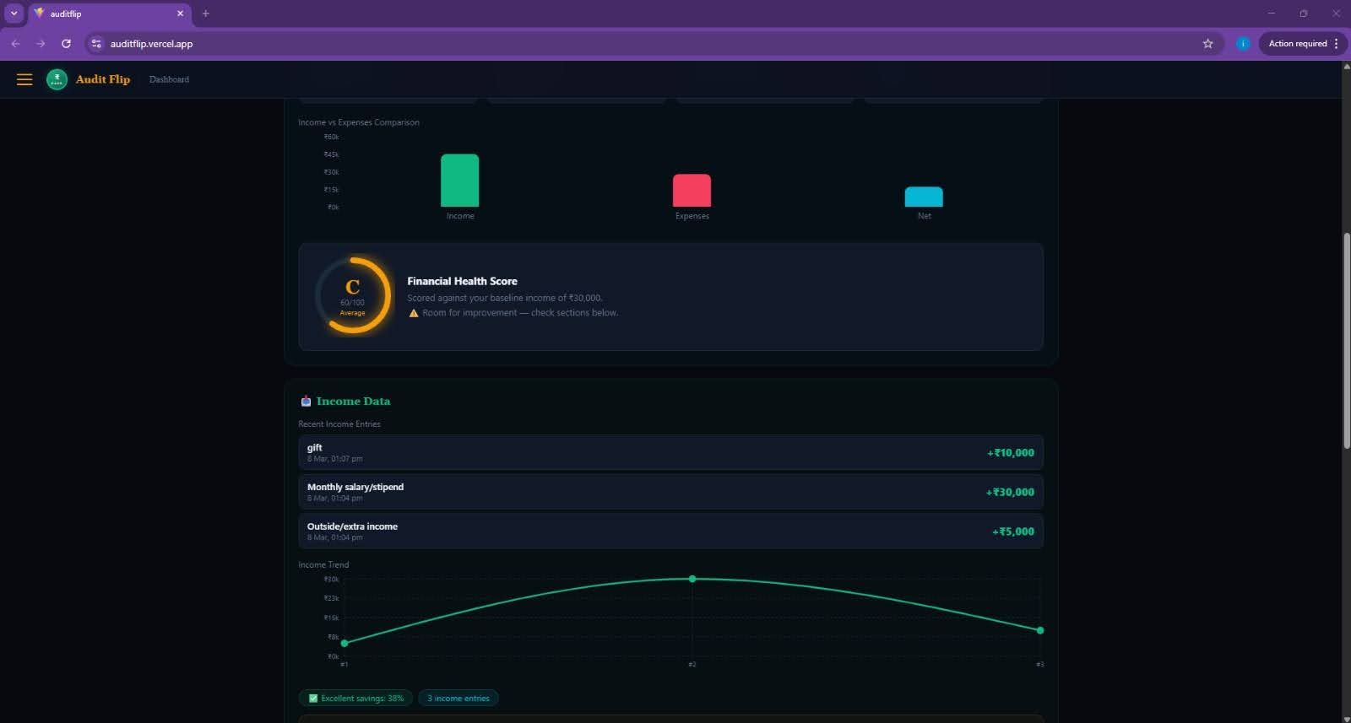
SHOWS INCOMES

Slide 16
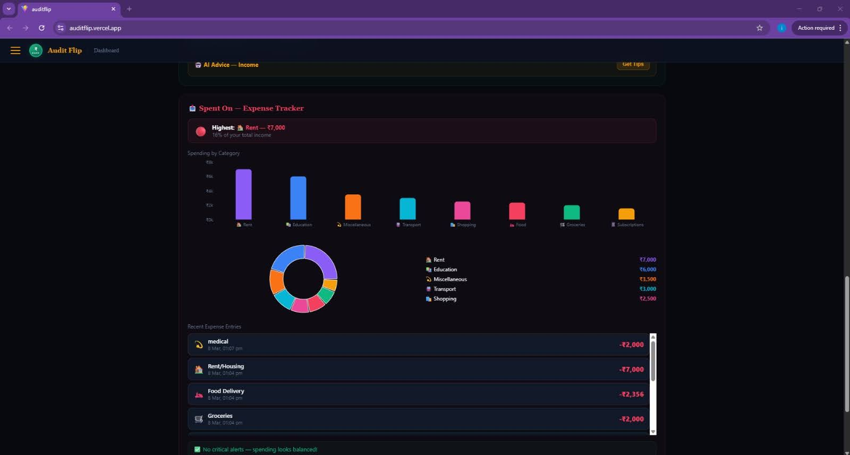
SHOWS EXPENSES

Slide 17
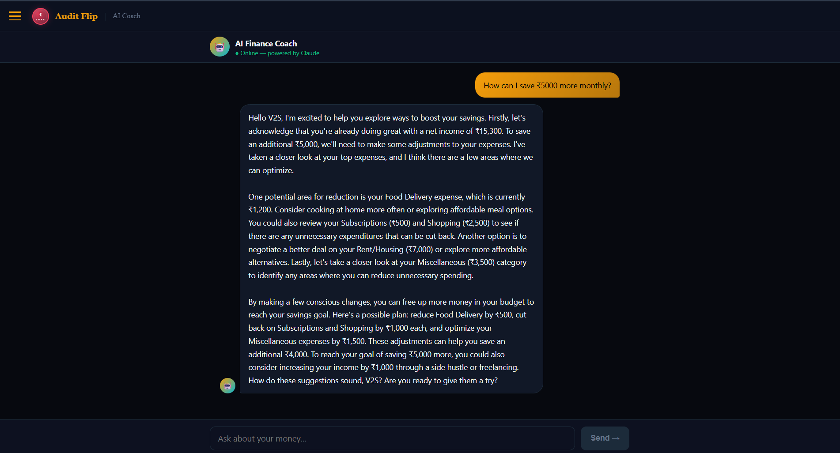
CAN REQUEST AI BOT
REGARDING OUR SPENDINGS
AND IT WILL ANSWER

Slide 18
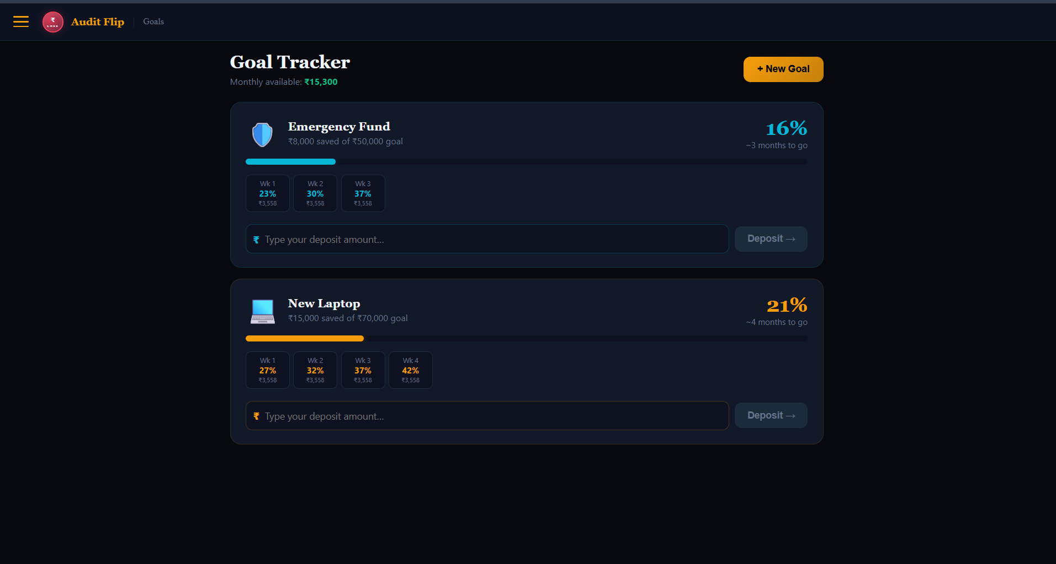
GOAL TRACKER SYSTEM
CAN ADD NEW GOALS BY CLICKING “NEW GOAL”

Slide 19
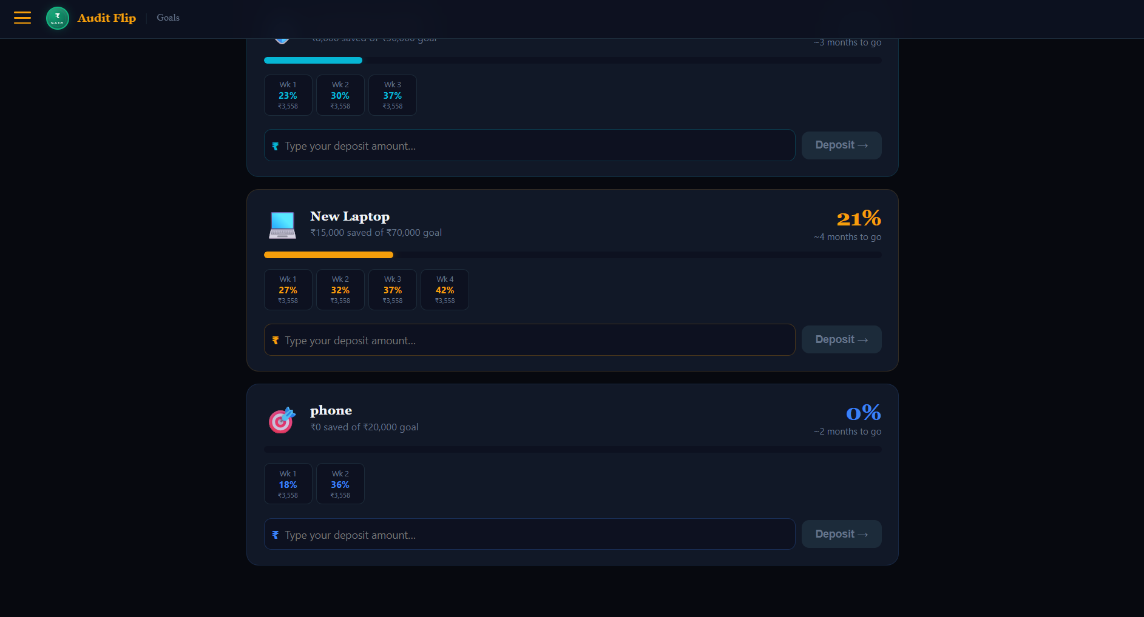

Slide 20
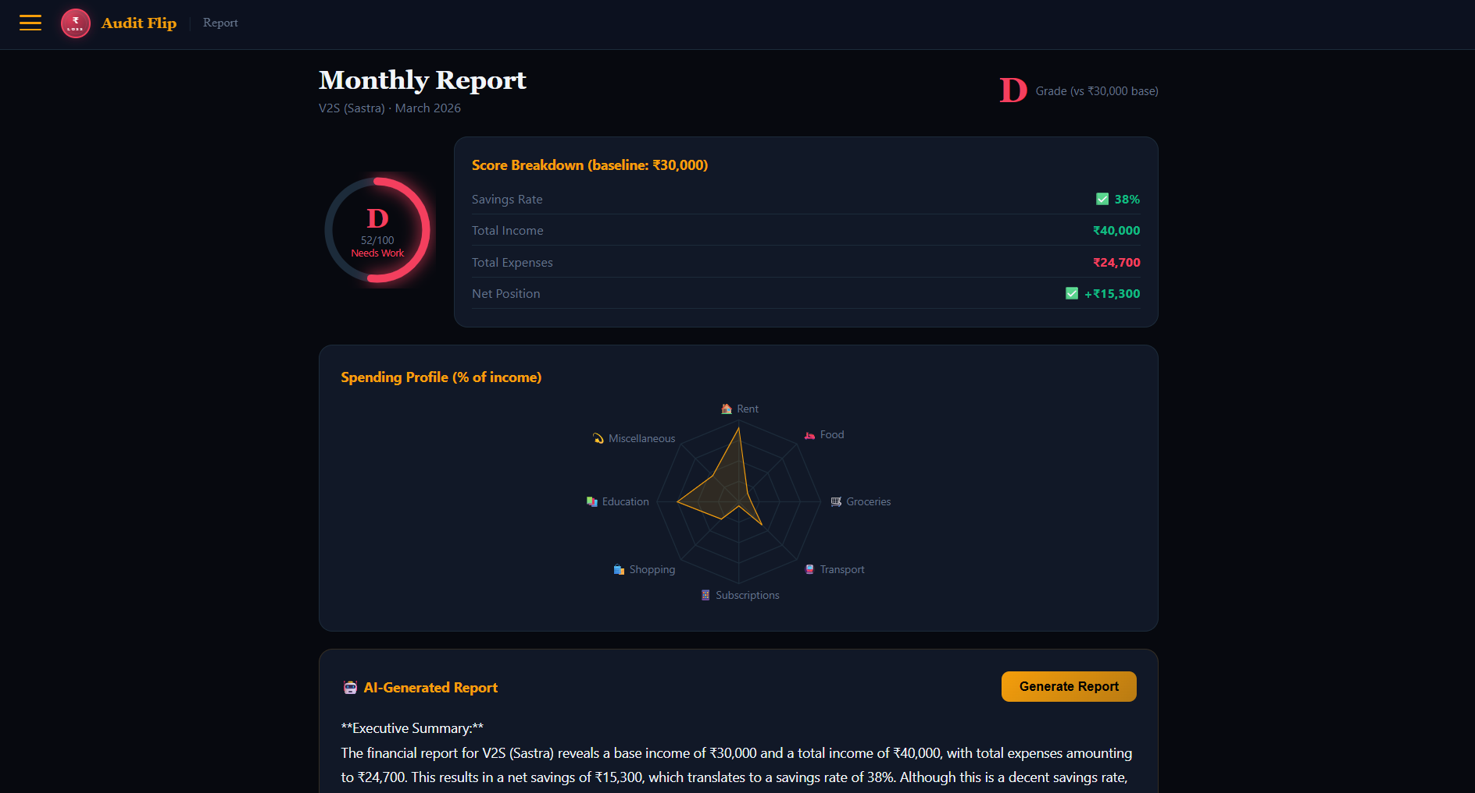
GENERATE REPORTS REGARDING EXPENSES

Slide 21
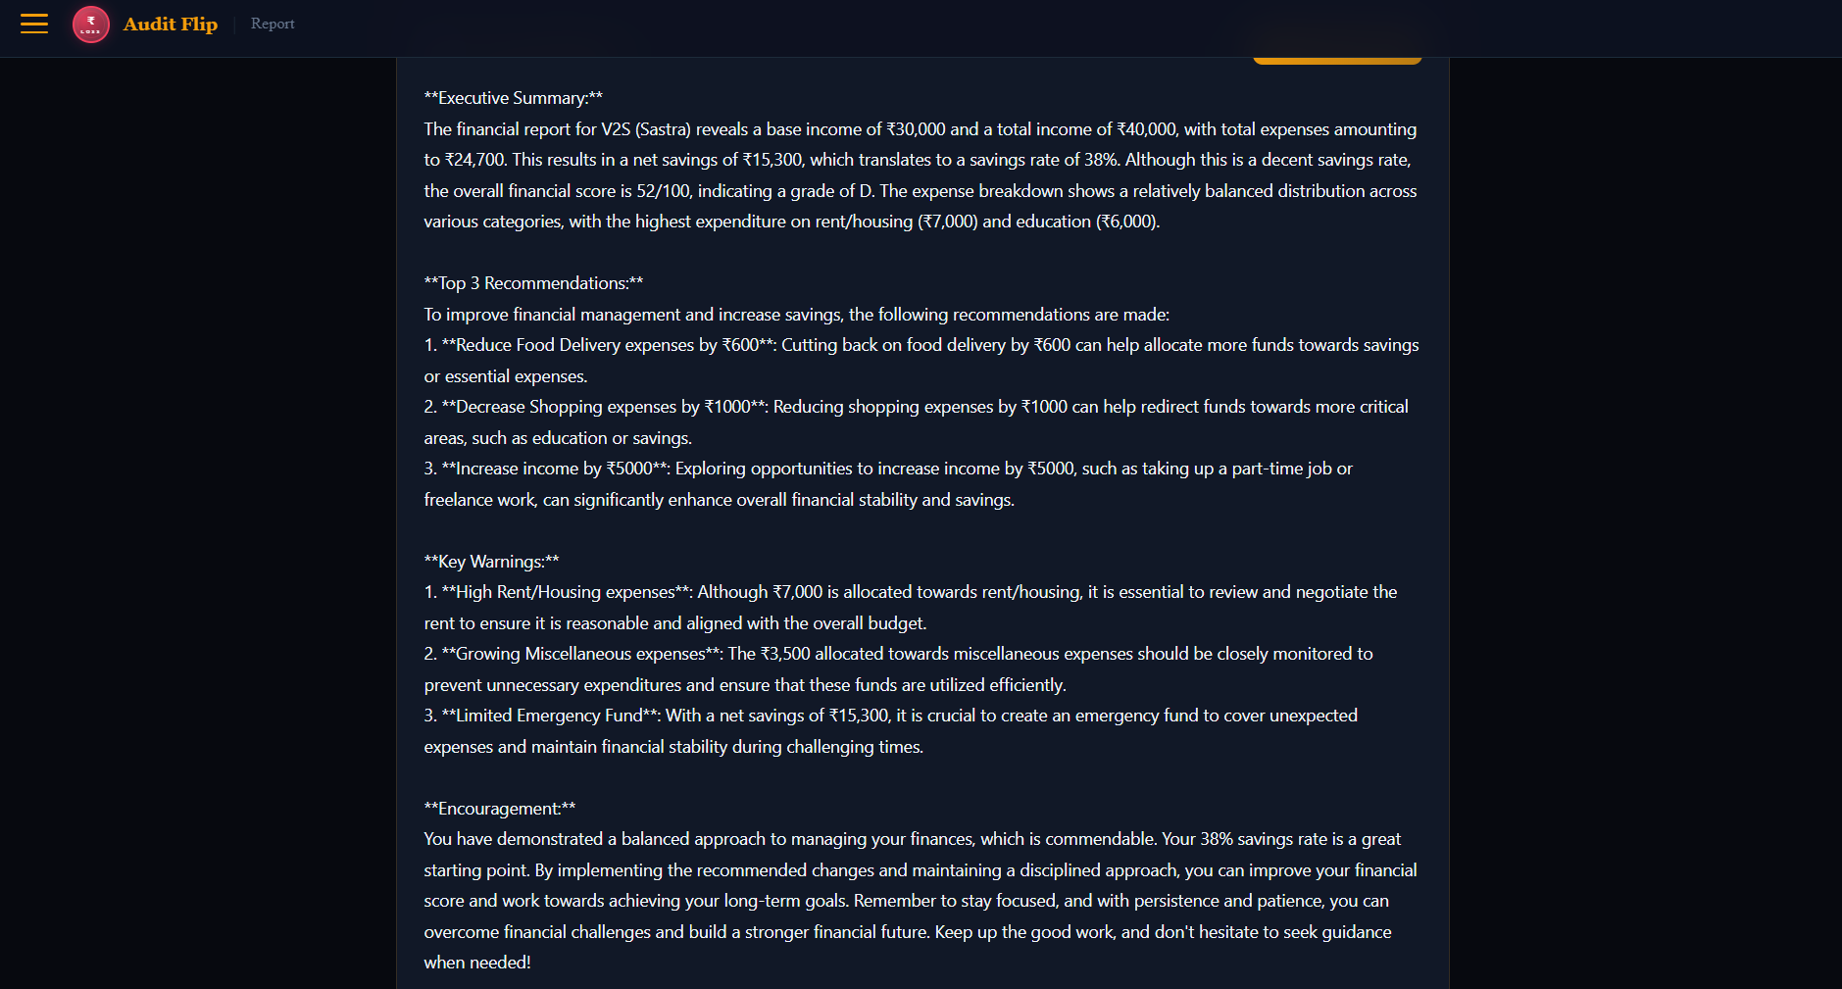
GENERATED REPORT

Slide 22

IT HAS THREE LANGUAGE SUPPORT
->ENGLISH
->HINDI
->TAMIL

Slide 23
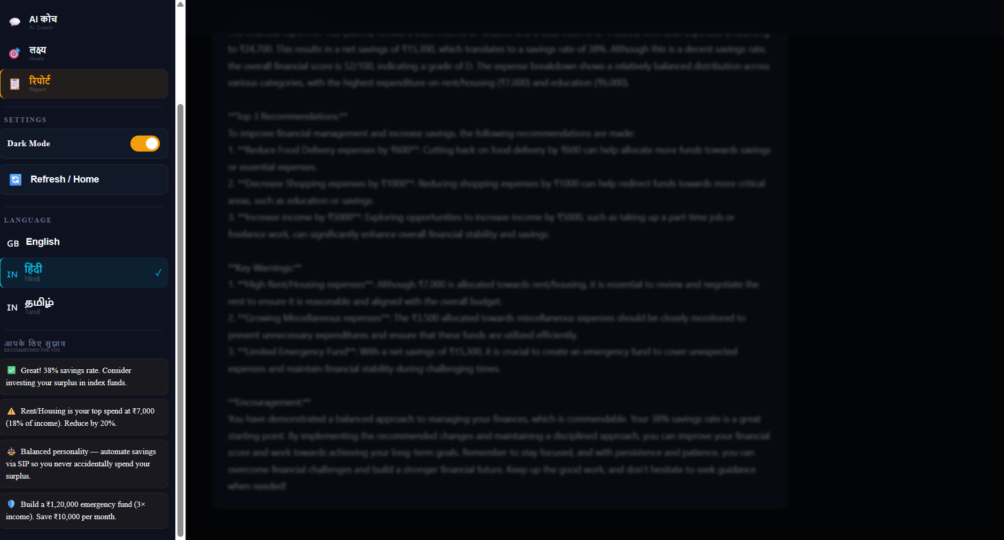
HINDI

Slide 24
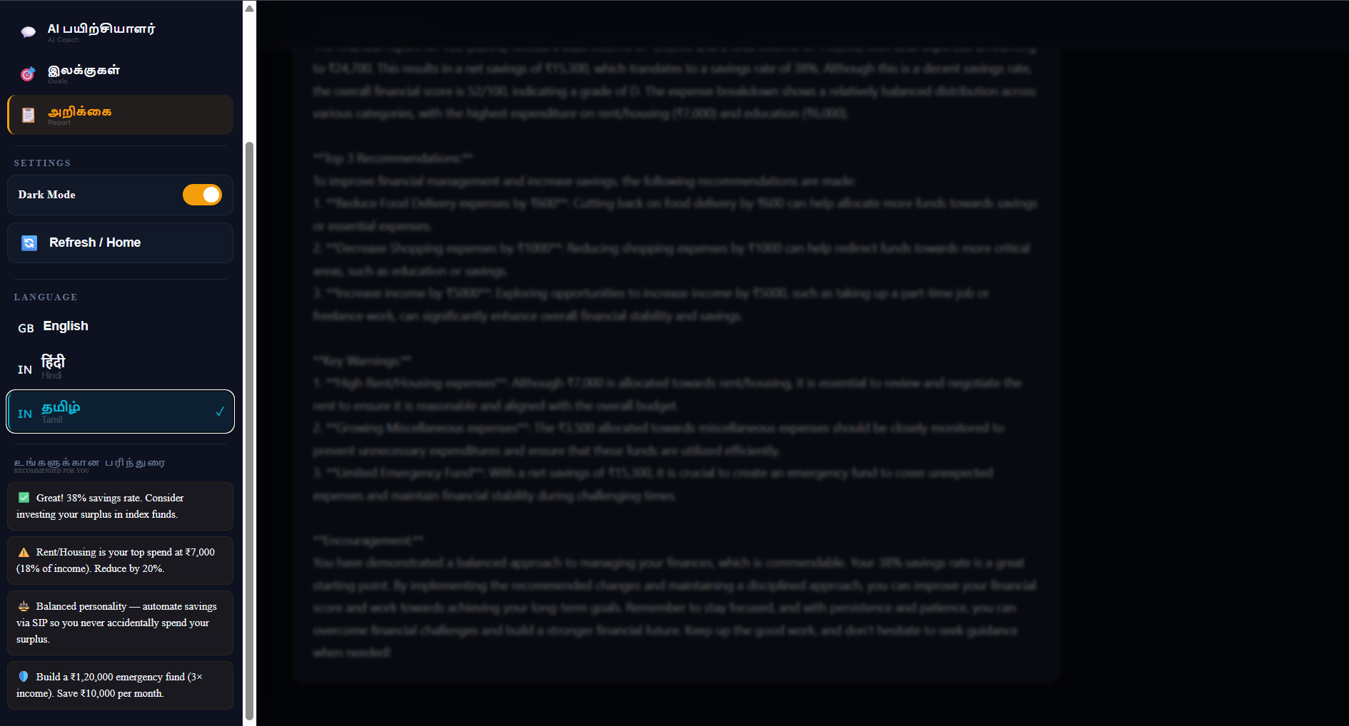
TAMIL

Slide 25
THANK YOU

